Slide 1
UNIT 2 PARSING
Context Free Grammar
Derivation
CFG vs R.E.
Types of Parser
Bottom up: Shift Reduce Parsing, Operator Precedence Parsing, SLR parser
Top Down: Recursive Descent Parser - Non-Recursive Descent Parser.

Slide 2
Syntax Analysis
Every programming language has rules that prescribe the syntactic structure of well-formed programs.
For example, in Pascal,
a program is made out of blocks,
a block out of statements,
a statement out of expressions,
an expressions out of tokens and so on.
The syntactic or the structural correctness of a program is checked during the syntax analysis phase of compilation.
The structural properties of language constructs can be specified in different ways.

Slide 3
Different Formalisms
Syntax diagram (SD),
Backus-Naur form (BNF), or
Context-free grammar (CFG).
Different styles of specification have different purpose.
SD is good for human understanding and visualization.
The BNF is very compact. It is used for theoretical analysis and
also in automatic parser generating softwares.
The syntactic specification of a programming language, written as a context-free grammar can be used to construct its parser by synthesizing a push-down automaton (PDA).

Slide 4
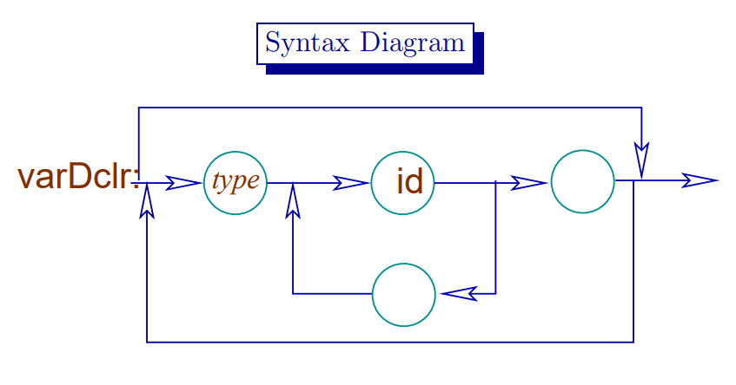
e.g.
Declaration statement
int a,b,c;

Slide 5
Grammars offer significant advantages to both language designers and compiler writers.
Gives a precise, easy-to-understand, syntactic specification of a programming language.
From certain classes of grammars an efficient parser can be automatically constructed that determines if a source program is syntactically well formed.
A properly designed grammar imparts a structure to a programming language that is useful for translation of source code into correct object code and for detection of errors.

Slide 6
Role of Parser
The parser obtains a string of tokens from the lexical analyzer and verifies that the string can be generated by the grammar.
The parser should report any syntax errors.
It should recover from errors so as to continue processing the remaining inputs.
Lexical Analyzer
token
Parser
Rest of front end
source
parse
intermediate
program
tree
representation
get next token
Symbol Table

Slide 7
Role of Parser (contd..)
Three types of parsers for grammars:
Universal Parsing method
Cocke-Younger-Kasami Algorithm
Earley’s Algorithm
Top-down Parsing
Build parse trees from the top(root) to the bottom(leaves)
Bottom-up Parsing
Build parse trees from the bottom(leaves) and work up to the root.

Slide 8
Role of Parser (contd..)
Assume that the output of the parser is some representation of the parse tree for the stream of tokens produced by lexical analyzer.
Other majors tasks:
Collecting information about various tokens into the symbol table.
Performing type checking and other semantic analysis.
Generating intermediate code.

Slide 9
Syntax Error Handling
The programs can contain errors at different levels.
e.g. errors can be
Lexical, such as misspelling of keywords, identifier or operator.
Syntactic, such as an arithmetic expression with unbalanced parenthesis
Semantic, such as an operator applied to an incompatible operand.
Logical, such as an infinitely recursive call.
The error detection and recovery in a compiler is centered around the syntax phase.

Slide 10
Syntax Error Handling
The error handler in a parser has simple-to-state goals:
It should report the presence of errors clearly and accurately.
It should recover from each error quickly enough to be able to detect subsequent errors.
It should not significantly slow down the processing of correct programs.

Slide 11
Error-recovery strategies
Panic mode
Discard input symbol one at a time until one of designated set of synchronization tokens is found.
Phrase level
Replacing a prefix of remaining input by some string that allows the parser to continue.
Error productions
Augment the grammar with productions that generate the erroneous constructs.
Global correction
Choosing minimal sequence of changes to obtain a globally least-cost correction.

Slide 12
Context Free Grammar(CFG)

Slide 13
Context-Free Grammar(CFG)
Many programming language constructs have an recursive structure that can be defined by CFG,
e.g. Conditional Statement defined by a rule,
If S₁ and S₂ are statements and E is an expression ,then
“if E then S₁ else S₂ “ is a statement (1)
This form of conditional statement cannot be specified using the regular expression.
Grammar specifications:
With the use of syntactic variable:
stmt to denote the class of statements, and
expr to denote the class of expressions,
We can express (1) as a grammar rule,
stmt → if expr then stmt else stmt

Slide 14
Context-Free Grammar(CFG)
CFG consists of terminals, non-terminals, start symbol, and productions.
Terminals:
Basic symbols from which strings are formed. i.e Tokens are terminals.
Non-terminals:
Syntactic variables that denote set of strings.
Helps to define the language generated by the grammar.
Start symbol:
One non-terminal that denotes the language defined by the grammar.
Productions:
Specify the manner in which the terminals and non-terminals can be combined to form strings.
Each production consists of a non-terminal , followed by an arrow→ , followed by a string of non-terminals and terminals.

Slide 15
Example
Consider the grammar for simple arithmetic expressions:
expr → expr op expr
expr → ( expr )
expr → - expr
expr → id
op → +
op → -
op → *
op → /
op → ^
Terminals : id + - * / ^ ( )
Non-terminals : expr , op
Start symbol : expr

Slide 16
Notational Conventions
These symbols are terminals:
Lower-case letters early in the alphabet such as a, b, c.
Operator symbols such as +, -, etc.
Punctuation symbols such as parentheses, comma etc.
Digits 0,1,…,9.
Boldface strings such as id or if (keywords)
2. These symbols are non-terminals:
Upper-case letters early in the alphabet such as A, B, C..
The letter S, when it appears is usually the start symbol.
Lower-case italic names such as expr or stmt.

Slide 17
Notational Conventions(contd..)
Upper-case letters late in the alphabet, such as X,Y,Z, represent grammar symbols, that is either terminals or non-terminals.
Greek letters α , β , γ represent strings of grammar symbols.
e.g a generic production could be written as A → α
If A → α₁ , A → α₂ , . . . . , A → α_{n} are all productions with A , then we can write A → α₁ | α₂ |. . . . | α_{n} , (alternatives for A).
Unless otherwise stated, the left side of the first production is the start symbol.

Slide 18
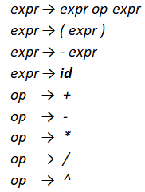
Using the shorthand, the grammar can be written as:
E → E A E | ( E ) | - E | id
A → + | - | * | / | ^

Slide 19
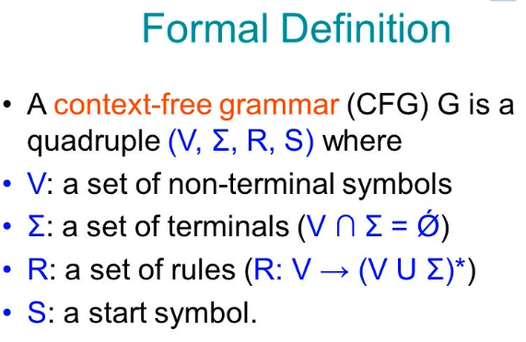

Slide 20
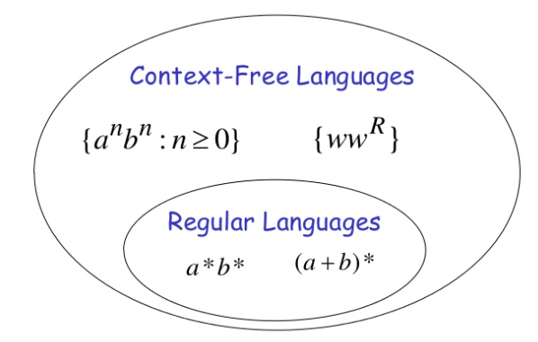
CFL vs RL
Any language that can be generated by a context free grammar is a context free language (CFL).
RL CFL – every regular language can be expressed by a CFG.

Slide 21
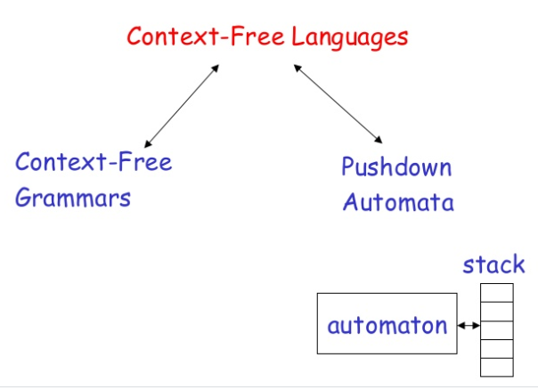

Slide 22
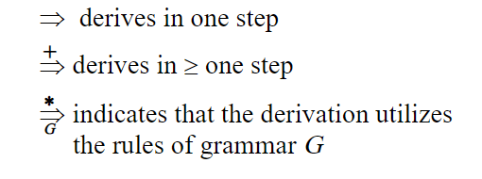
Derivations
A derivation of a string for a grammar is a sequence of grammar rule applications that transform the start symbol into the string. A derivation proves that the string belongs to the grammar's language.

Slide 23
To create a string from a context-free grammar:
Begin the string with a start symbol.
Apply one of the production rules to the start symbol on the left-hand side by replacing the start symbol with the right-hand side of the production.
Repeat the process of selecting non-terminal symbols in the string, and replacing them with the right-hand side of some corresponding production, until all non-terminals have been replaced by terminal symbols.

Slide 24
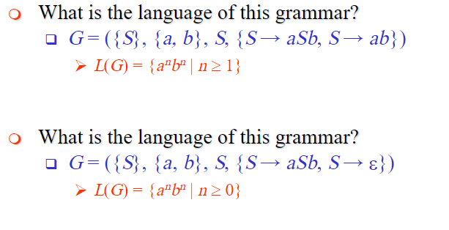
Example

Slide 25
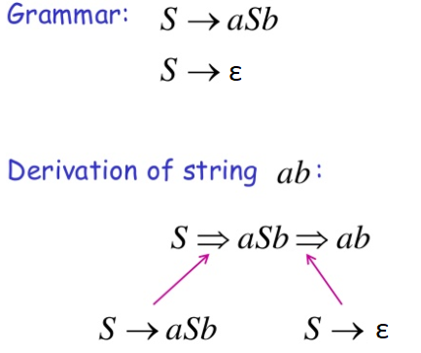
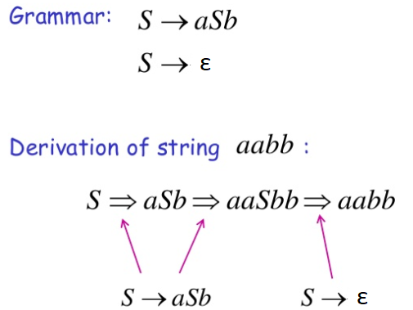

Slide 26
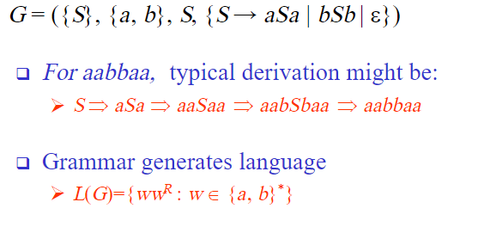
Example

Slide 27
CFG: Parsing
Parser :
A program that determines if a string w ϵ L(G) by constructing a derivation ,where G represent the grammar.
Top-down parsers :
Constructs the derivation tree from root to leaves.
Leftmost derivation.
Bottom-up parsers :
Constructs the derivation tree from leaves to root.
Rightmost derivation in reverse.

Slide 28
Next Topic:
Derivations and Parse tree

Slide 29
Derivations
A production is treated as a rewriting rule in which the non-terminal on the left is replaced by the string on the right side of the production.
e.g. Consider the grammar for arithmetic expression
E → E + E
E → E * E
E → ( E ) E → E + E | E * E | (E ) | - E | id
E → - E
E → id

Slide 30

Consider the G,
E → E + E | E * E | (E ) | - E | id
Derive the string id + id * id
E => E + E
=> id + E
=> id + E * E
=> id + id * E
=> id + id * id
Each step of derivation is a Sentential Form
Sentence

Slide 31
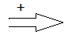
Context Free Language
Given a grammar G with start symbol S,
define L(G) ,the language generated by G.
i.e. Derives in one or more steps.
The string in L(G) contain only terminals.
A string of terminals w is in L(G) if and only if S w
where w is called the sentence of G.
If S α ,where α may contain non-terminals, then we say that α is a sentential form of G.
A sentence is a sentential form with no non-terminals.

Slide 32
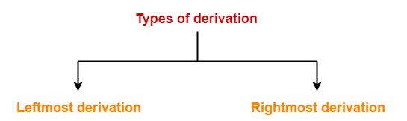
Derivations
A derivation is basically a sequence of production rules, in order to get the input string. During parsing, we take two decisions for some sentential form of input:
Deciding the non-terminal which is to be replaced.
Deciding the production rule, by which, the non-terminal will
be replaced.
To decide which non-terminal to be replaced with production rule, we can have two options.

Slide 33
Types of Derivation
Leftmost Derivation(LMD):
If the sentential form of an input is scanned and replaced from left to right, it is called left-most derivation.
The sentential form derived by the left-most derivation is called the left-sentential form.
Rightmost Derivation(RMD):
If we scan and replace the input with production rules, from right to left, it is known as right-most derivation.
The sentential form derived from the right-most derivation is called the right-sentential form.

Slide 34
Parse Tree or Derivation Tree
A parse tree is a graphical representation of a derivation sequence of a sentential form.
In a parse tree:
All leaf nodes are terminals.
All interior nodes are non-terminals.
In-order traversal gives original input string.
A parse tree depicts associativity and precedence of operators.
The deepest sub-tree is traversed first, therefore the operator in that sub-tree gets precedence over the operator which is in the parent nodes.

Slide 35
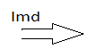
Example 1
Consider the G,
E → E + E | E * E | (E ) | - E | id
Derive the string id + id * id using leftmost derivation
E E + E
id + E
id + E * E
id + id * E
id + id * id
Parse Tree
E
E
+
E
id
E
*
E
id
id

Slide 36
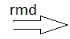
Example 1
Consider the G,
E → E + E | E * E | (E ) | - E | id
Derive the string id + id * id using rightmost derivation
E E + E
E + E * E
E + E * id
E + id * id
id + id * id
Parse Tree
E
E
+
E
id
E
*
E
id
id

Slide 37
Example 2
Derive the string - ( id + id ) * id using rightmost /leftmost derivation.
Leftmost Derivation:
E E * E E * E
- E * E E * id
- ( E ) * E - E * id
- ( E + E ) * E - ( E ) * id
- ( id + E ) * E - ( E + E ) * id
- ( id + id ) * E - ( E + id ) * id
- ( id + id ) * id - ( id + id ) * id
E → E + E | E * E | (E ) | - E | id

Slide 38
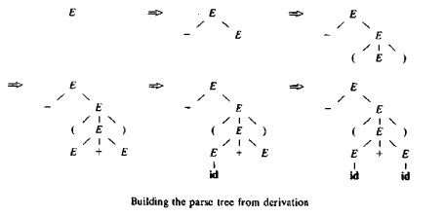
Example 3
Derive the string - ( id + id )
E - E
- ( E )
- ( E + E )
- ( id + E )
- ( id + id )
E → E + E | E * E | (E ) | - E | id

Slide 39
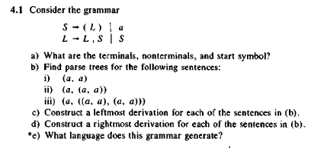
Practice

Slide 40
Next Topic:
Ambiguity

Slide 41
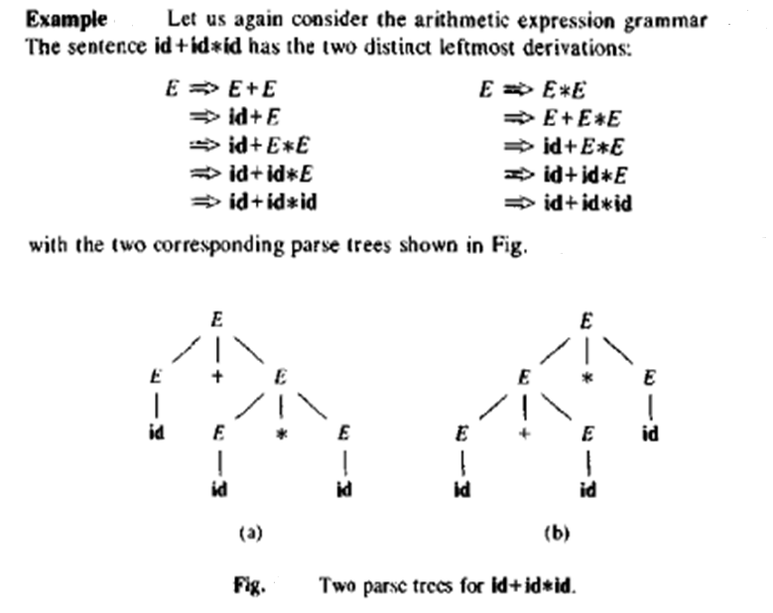

Slide 42
Ambiguity
A grammar that produces more than one parse tree for some sentence is said to be ambiguous.
i.e. An ambiguous grammar is one that produce more than one leftmost or more than one rightmost derivation for the same sentence.
For certain types of parsers, it is desirable that the grammar be made unambiguous.
We need to design unambiguous grammars for compiling applications.

Slide 43
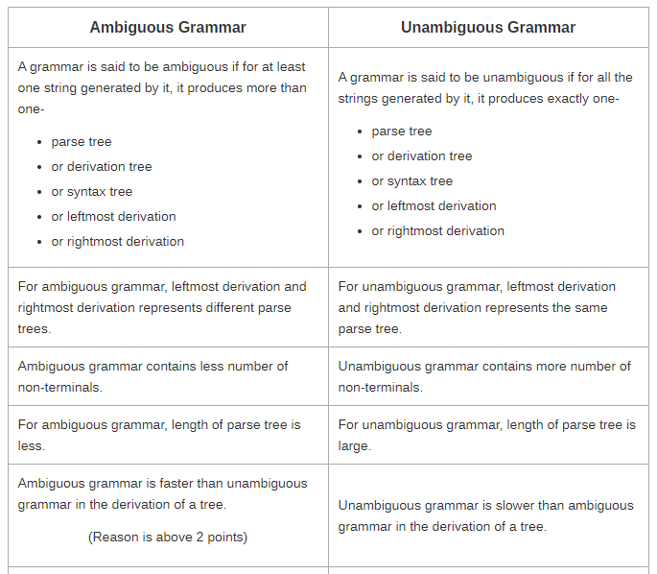
Ambiguous vs. Unambiguous

Slide 44
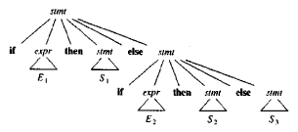
Eliminating Ambiguity
An ambiguous grammar can be rewritten to eliminate the ambiguity.
e.g. Eliminate the ambiguity from “dangling-else” grammar,
stmt → if expr then stmt
| if expr then stmt else stmt
| other
According to this grammar define a compound conditional statement,

Slide 45
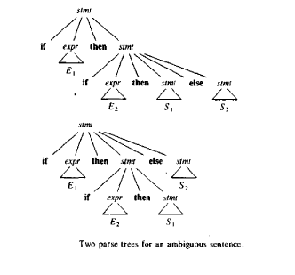
For the same grammar, consider the string,
The grammar is ambiguous since the string produces two parse tree,

Slide 46
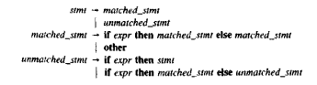
Match each else with the closest previous unmatched then.
This disambiguity rule can be incorporated into the grammar.
This grammar generates the same set of strings ,but allows only one parsing for string.

Slide 47
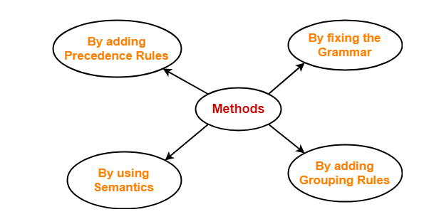
Methods To Remove Ambiguity
The ambiguity from the grammar may be removed using the following methods:
The solution to the problem of enforcing precedence is to introduce several different variables at each level of precedence.

Slide 48
Removing Ambiguity by Precedence & Associativity Rules
An ambiguous grammar may be converted into an unambiguous grammar by implementing:
Precedence Constraints
Associativity Constraints
These constraints are implemented using the following rules:
Rule-1:
The level at which the production is present defines the priority of the operator contained in it.
The higher the level of the production, the lower the priority of operator.
The lower the level of the production, the higher the priority of operator.
Rule-2:
If the operator is left associative, induce left recursion in its production.
If the operator is right associative, induce right recursion in its production.

Slide 49
Example
Consider the ambiguous Grammar:
E → E + E |E – E | E * E | E / E | (E) | id
Introduce new variable / non-terminals at each level of precedence,
an expression E for our example is a sum of one or more terms. (+,-)
a term T is a product of one or more factors. (*, /)
a factor F is an identifier or parenthesised expression.
Unambiguous Grammar
E → E + T | E – T | T
T → T * F | T / F | F
F → (E) | id

Slide 50
Unambiguous Grammar
E → E + T | T
T → T * F | F
F → (E) | id
Try deriving the string id+id*id using the above grammars.
E E + T
T + T
F + T
id + T
id + T * F
id + F * F
id + id * F
id + id * id

Slide 51
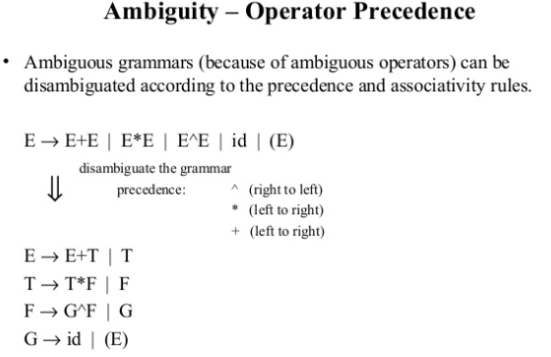

Slide 52
RE vs. CFG
Every construct that can be described by a regular expression can be described by a grammar.
NFA can be converted to a grammar that generates the same language as recognized by the NFA.
Rules:
For each state i of the NFA, create a non-terminal symbol A_{i} .
If state i has a transition to state j on symbol a, introduce the production A_{i} → a A_{j}
If state i goes to state j on symbol ε, introduce the production A_{i} → A_{j}
If i is an accepting state, introduce A_{i} → ε
If i is the start state make A_{i} the start symbol of the grammar.

Slide 53
RE vs. CFG(contd..)
e.g. The regular expression (a|b)*abb, consider the NFA
Equivalent grammar,
A₀ → a A₀ | b A₀ | a A₁
A₁ → b A₂
A₂ → b A₃
A₃ → ε
a
start
a
b
b
0
1
2
3
b

Slide 54
Types of parser
Types of Parser
Top-Down Parser
Bottom-Up Parser
Backtracking
Predictive Parser
LR Parser
Shift-Reduce Parser
1.Recursive Descent Parsing
2.Non-Recursive Descent Parsing
LR
SLR
LALR

Slide 55
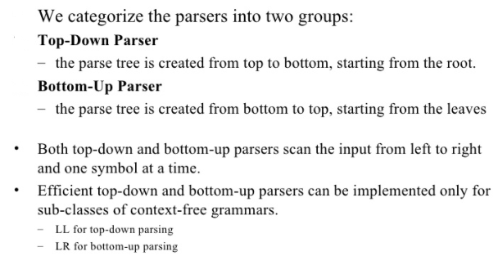

Slide 56
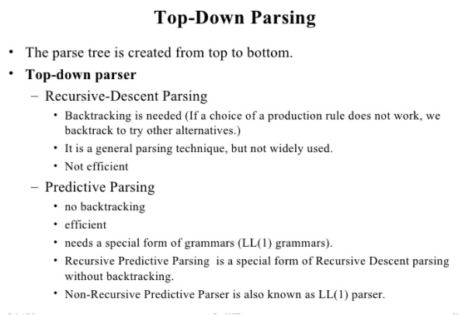

Slide 57
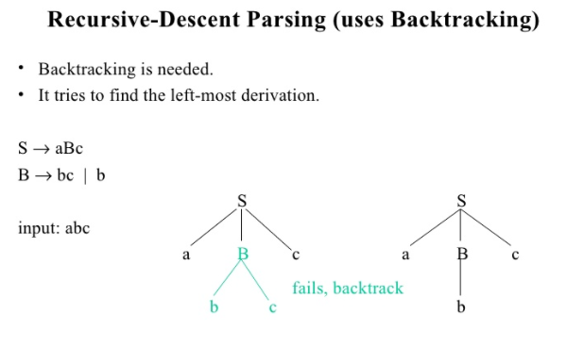

Slide 58
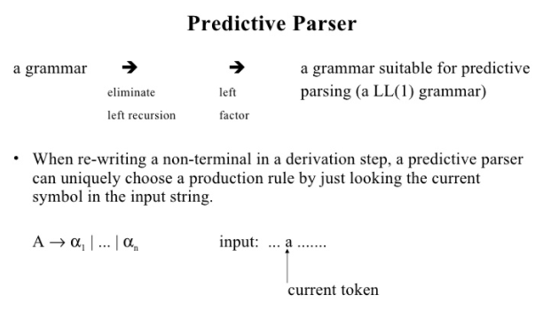

Slide 59
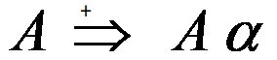

Elimination of Left Recursion
A grammar is left recursive, if it has a non terminal A such that there is a derivation, for some string α.
Top-down parsing techniques cannot handle left-recursive grammars.
So, convert left-recursive grammar into an equivalent grammar which is not left-recursive.
The left-recursion may appear in a single step of the derivation(immediate left-recursion), or may appear in more than one step of the derivation.
Note: The grammar with no cycles and no ε-productions.
(i.e. and A → ε )

Slide 60
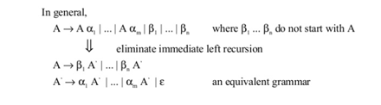
Immediate Left-Recursion
where β does not start with A
eliminate immediate left recursion
an equivalent grammar

Slide 61
Example Grammar
E -> E + T | T A -> A α | β
E -> T E’ A -> β A’
E’ -> + T E’| ε A’ -> α A’ | ε
E->E+T |T
T->T*F | F
F->(E)|id
E->TE’
E’->+TE’|ε
T->FT’
T’->*FT’|ε
F->(E)
F->id

Slide 62
Example
Consider the Grammar:
S → Aa | b
A → Ac | Sd | ε
The non-terminal S is left recursive because S=> Aa => Sda, but it is not immediate left recursive.
On substituting S - production in A →Sd , we get,
A →Ac | Aad | bd | ε
Hence, the new Grammar is:
S → Aa | b
A →Ac | Aad | bd | ε
Eliminating the immediate left recursion among the A-production yields the following grammar,
S → Aa | b
A → bdA’| A’
A’ → cA’ |ad A’ |ε

Slide 63
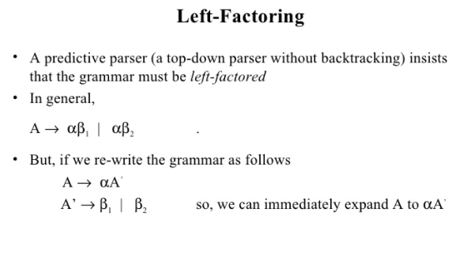

Slide 64
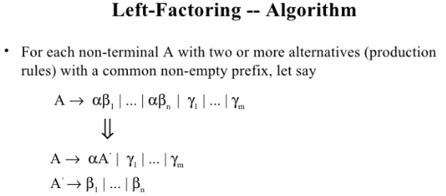

Slide 65
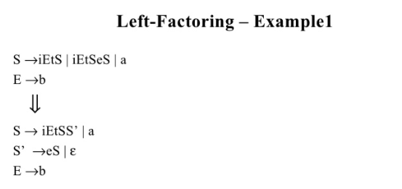

Slide 66
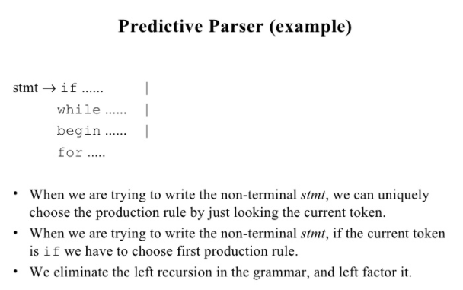

Slide 67
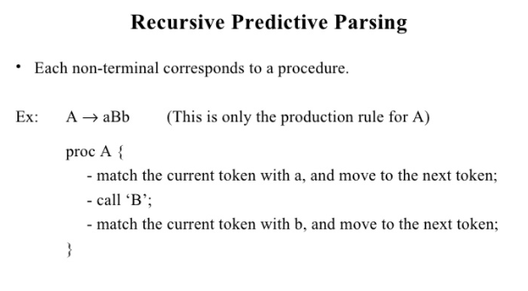

Slide 68
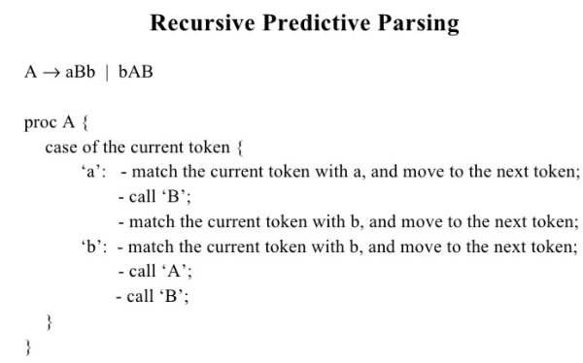

Slide 69
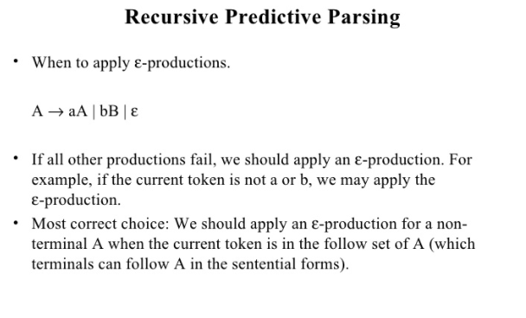

Slide 70
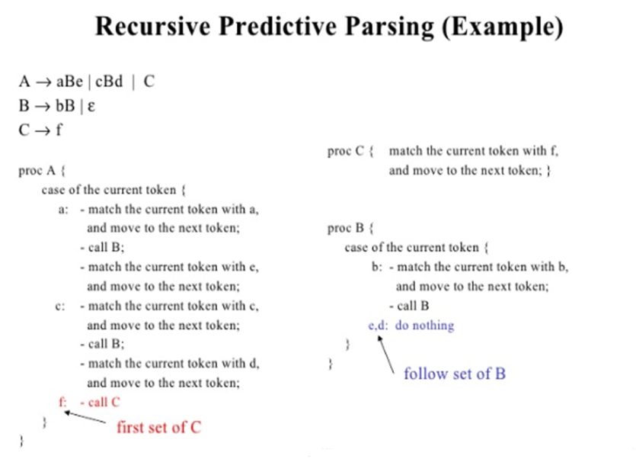

Slide 71
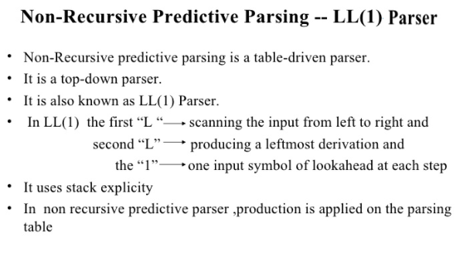

Slide 72
Model of Non-Recursive Predictive Parser
INPUT
 | a | + | b | $
STACK
X
Y
Z
$
Predictive Parsing Program
OUTPUT
Parsing Table
M

Slide 73
Predictive Parser(contd..)
A table driven predictive parser has:
an input buffer, $ is used to mark end of string
stack, $ at bottom of the stack.
a parsing table and
an output stream.
The construction of a predictive parser is aided by two functions associated with the grammar G.
FIRST()
FOLLOW()
These functions will fill the entries of a predictive parsing table for G, whenever possible.

Slide 74
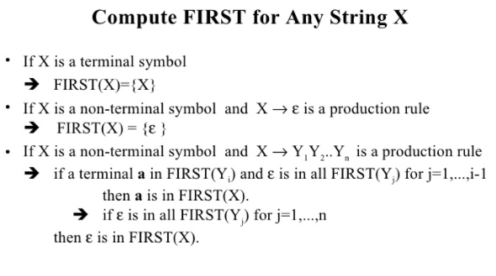

Slide 75
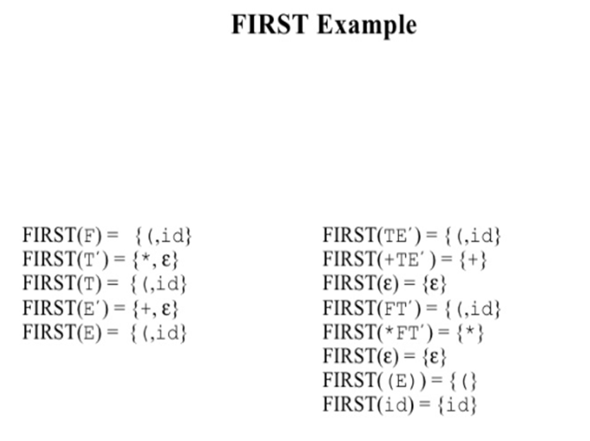
E→TE’
E’ → +TE’|ε
T → FT’
T’ → *FT’|ε
F →(E)
F → id

Slide 76
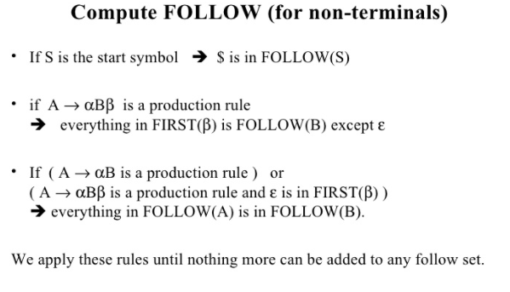

Slide 77
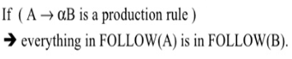
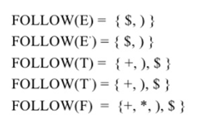
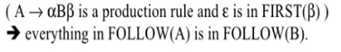
FOLLOW Example
E:
F →(E)
FOLLOW(E)={$,)}
E’:
E→TE’
E’ → +TE’
FOLLOW(E’)=FOLLOW(E)={$,)}
T:
E→TE’
E’ → +TE’
FOLLOW(T)={FIRST(E’)}={+, ε}
={ +,FOLLOW(E)} ={+,$,) }
E→TE’
E’ → +TE’|ε
T → FT’
T’ → *FT’|ε
F →(E)
F → id

Slide 78
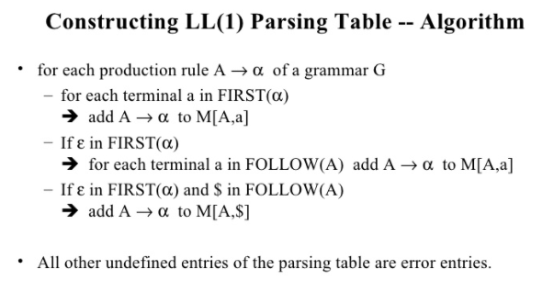

Slide 79
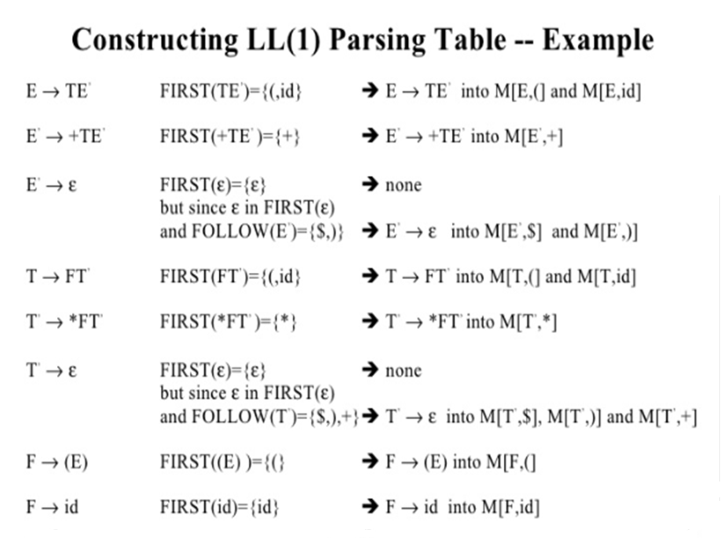

Slide 80
Predictive Parsing Table M[X,a]
X-Non terminal (row)
a- Terminal (column)
blank entries – error entries
M[X,a] | id | + | * | ( | ) | $
E | E →TE’ |  |  | E →TE’
E’ |  | E’ →+TE’ |  |  | E’ →ε | E’ →ε
T | T →FT’ |  |  | T →FT’
T’ |  | T’ →ε | T’ →*FT’ |  | T’ →ε | T’ →ε
F | F →id |  |  | F → (E)

Slide 81
Predictive parsing program
set ip to point to the first symbol of w$;
repeat
let X be the top stack symbol and a the symbol pointed to by ip;
if X is a terminal or $ then
If X=a then
pop X from the stack and advance ip
else error()
else /* X is a nonterminal */
if M[X,a]=X →Y₁ Y₂ ....... Y_{k} then begin
pop X from the stack;
push Y_{k} , Y_{k-1} ........ Y₁ onto the stack ,with Y₁ on top;
output the production X → Y₁ Y₂ ...... Y_{k}
end
else error()
until X=$ /* stack is empty */

Slide 82
 | id | + | * | ( | ) | $
E | E →TE’ |  |  | E →TE’
E’ |  | E’ →+TE’ |  |  | E’ →ε | E’ →ε
T | T →FT’ |  |  | T →FT’
T’ |  | T’ →ε | T’ →*FT’ |  | T’ →ε | T’ →ε
F | F →id |  |  | F → (E)
STACK | INPUT | OUTPUT
$E | id+id*id$ | E →TE’
$E’T | id+id*id$ | T →FT’
$E’T’F | id+id*id$ | F →id
$E’T’id | id+id*id$ | pop
$E’T’ | +id*id$ | T’ →ε
$E’ | +id*id$ | E’ →+TE’
$E’T+ | +id*id$ | pop
$E’T | id*id$ | T →FT’
$E’T’F | id*id$ | F →id
$E’T’id | id*id$ | Pop
$E’T’ | *id$ | T’ →*FT’
$E’T’F* | *id$ | Pop
$E’T’F | id$ | F →id
$E’T’id | id$ | Pop
$E’T’ | $ | T’ →ε
$E’ | $ | E’ →ε
$ | $ | Accept

Slide 83
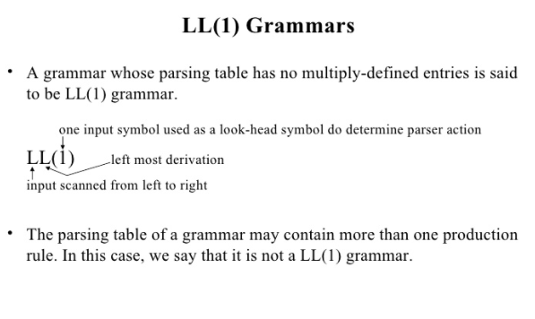

Slide 84
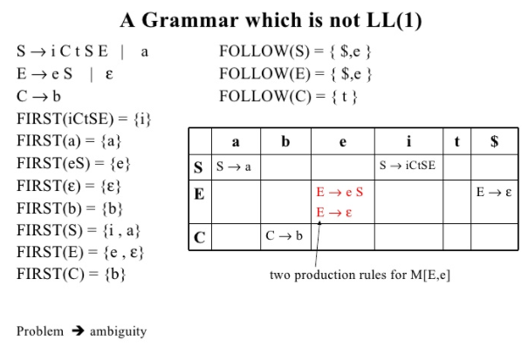

Slide 85
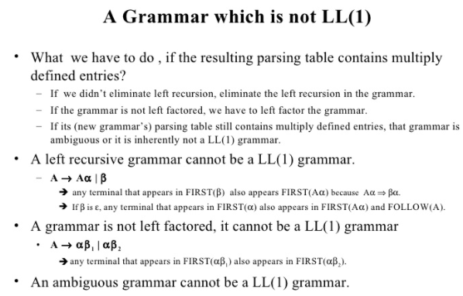

Slide 86
Exercise
1.Show that the following grammar is LL(1).
S → AaAb | BbBa
A →ε
B → ε
2. Consider the following Grammar:
S → ( L ) | a
L → L , S | S
Implement the predictive parser and check the validity of the string (a,(a,a))
3. Show that the grammar is LL(1):
S → L = R
S → R
L → * R
L → id
R → L

Slide 87
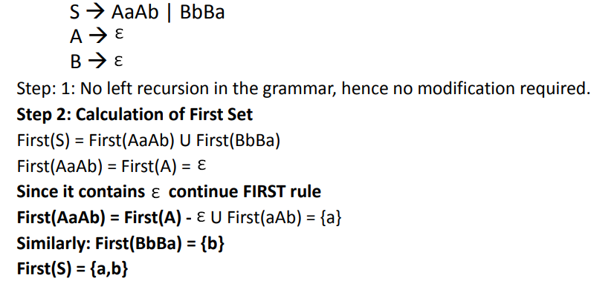
Problem 1:

Slide 88




Slide 89
NEXT TOPIC
BOTTOM-UP PARSING

Slide 90
Types of parser
Types of Parser
Top-Down Parser
Bottom-Up Parser
Backtracking
Predictive Parser
LR Parser
Shift-Reduce Parser
LR
SLR
LALR
Operator Precedence Parser

Slide 91


Slide 92


Slide 93

S aABe
aAde
aAbcde
abbcde
Derivation
Reduction
S
a
e
A
B
A
b
c
d
b

Slide 94


Slide 95


Slide 96


Slide 97


Slide 98
Example for Choosing Handle
Consider the grammar
E→E+E
E→E-E
E→(E)
E→id
The rightmost derivation: id + id * id
E E + E E * E
E + E * E E* id
E + E * id E + E * id
E + id * id E + id * id
id + id * id id + id * id
Ambiguous Grammar

Slide 99


Stack implementation of Shift Reduce Parser

Slide 100


Slide 101


Slide 102


Slide 103


Slide 104


Slide 105


Slide 106

In operator-precedence parsing ,we define three disjoint precedence relations between pair of terminals.

Slide 107


Slide 108


Slide 109
Defining Precedence Relations
The precedence relations are defined using the following rules:
Rule-01:
If precedence of b is higher than precedence of a, then we define a < b
If precedence of b is same as precedence of a, then we define a = b
If precedence of b is lower than precedence of a, then we define a > b
Rule-02:
An identifier is always given the higher precedence than any other symbol.
$ symbol is always given the lowest precedence.
Rule-03:
If two operators have the same precedence, then we go by checking their associativity.

Slide 110

Operator-Precedence Relations from Associativity and Precedence

Slide 111


Operator-Precedence Relations

Slide 112


Slide 113

Example

Slide 114
Operator-Precedence Parser
An operator-precedence parser is a simple shift-reduce parser that is capable of parsing a subset of LR(1) grammars.
More precisely, the operator-precedence parser can parse all LR(1) grammars where two consecutive non-terminals and epsilon never appear in the right-hand side of any rule.
Steps involved in Parsing:
Ensure the grammar satisfies the pre-requisite.
Computation of the function LEADING()
Computation of the function TRAILING()
Using the computed leading and trailing ,construct the operator Precedence Table
Parse the given input string based on the algorithm
Compute Precedence Function and graph.

Slide 115

Computation of LEADING
Leading is defined for every non-terminal.
Terminals that can be the first terminal in a string derived from that non-terminal.
LEADING(A)={ a| A γaδ },where γ is ε or any non-terminal, indicates derivation in one or more steps, A is a non-terminal.
Algorithm for LEADING(A):
{
1. ‘a’ is in LEADING(A) is A→ γaδ where γ is ε or any non-terminal.
2.If ‘a’ is in LEADING(B) and A→B, then ‘a’ is in LEADING(A).
}

Slide 116

Consider the unambiguous grammar as an example:
LEADING(E)= { +,LEADING(T)} ={+ , * , ( , id}
LEADING(T)= { *,LEADING(F)} ={* , ( , id}
LEADING(F)= { ( , id}

Slide 117
Computation of TRAILING
Trailing is defined for every non-terminal.
Terminals that can be the last terminal in a string derived from that non-terminal.
TRAILING(A)={ a| A γaδ },where δ is ε or any non-terminal, indicates derivation in one or more steps, A is a non-terminal.
Algorithm for TRAILING(A):
{
1. ‘a’ is in TRAILING(A) is A→ γaδ where δ is ε or any non-terminal.
2.If ‘a’ is in TRAILING(B) and A→B, then ‘a’ is in TRAILING(A).
}

Slide 118
Consider the unambiguous grammar as an example:
TRAILING(E)= { +, TRAILING(T)} ={+ , * , ) , id}
TRAILING(T)= { *, TRAILING(F)} ={* , ) , id}
TRAILING(F)= { ) , id}

Slide 119
Construction of Precedence Table
After computing LEADING and TRAILING ,the table is constructed between all the terminals in the grammar including the ‘$’ symbol.
ALGORITHM:
{
for each production A→X₁ X₂ X₃ ... X_{n}
for i=1 to n-1
1. if X_{i} and X_{i+1} are terminals
set X_{i} X_{i+1}
2. if i ≤ n-2 and X_{i} and X_{i+2} are terminals and X_{i+1} is a non-terminal,
set X_{i} X_{i+2}
3. if X_{i} is a terminal and X_{i+1} is a non-terminal ,then for all ‘a’ in
LEADING(X_{i+1} )
set X_{i} a
4. if X_{i} is a non-terminal and X_{i+1} is a terminal ,then for all ‘a’ in
TRAILING(X_{i})
set a X_{i+1}
5. Set $ Leading(S) and Trailing(S) $,where S-start symbol.
}

Slide 120
Precedence table
 | + | * | id | ( | ) | $
+ | > | < | < | < | > | >
* | > | > | < | < | > | >
id | > | > | e | e | > | >
( | < | < | < | < | = | e
) | > | > | e | e | > | >
$ | < | < | < | < | e | Accept
LEADING(E)= {+ , * , ( , id}
LEADING(T)= {* , ( , id}
LEADING(F)= { ( , id}
T followed by NT
Rule-1. + T
+ < leading(T)
Rule-3. * F
* < leading(F)
Rule-4. ( E
( < leading(E)
TRAILING(E)= {+ , * , ) , id}
TRAILING(T)= {* , ) , id}
TRAILING(F)= { ) , id}
NT followed by T
Rule-1. E +
Trailing(E) > +
Rule-3. T *
Trailing(T) > *
Rule-4. E )
Trailing(E) > )

Slide 121
Parse the string
 | STACK | REL. | INPUT | ACTION
 | $ | $ < ( | (id+id)*id$ | Shift (
 | $( | ( < id | id+id)*id$ | Shift id
( < id | $( id | id > + | +id)*id$ | Pop id
 | $( | ( < + | +id)*id$ | Shift +
 | $(+ | + < id | id)*id$ | Shift id
+< id | $(+id | id > ) | )*id$ | Pop id
( < + | $(+ | + > ) | )*id$ | Pop +
 | $( | ( = ) | )*id$ | Shift )
( =) $ <( | $() $( | ) > * | *id $ | Pop ) Pop (
 | $ | $ < * | *id $ | Shift *
 | $* | *<id | id$ | Shift id
*<id | $*id | id >$ | $ | Pop id
$< * | $* | *>$ | $ | Pop *
 | $ |  | $ | Accept
 | + | * | id | ( | ) | $
+ | > | < | < | < | > | >
* | > | > | < | < | > | >
id | > | > | e | e | > | >
( | < | < | < | < | = | e
) | > | > | e | e | > | >
$ | < | < | < | < | e | Accept

Slide 122


Slide 123
Precedence Functions
Algorithm for Constructing Precedence Functions
Create functions f_{a} for each grammar terminal a and for the end of string symbol.
Partition the symbols in groups so that f_{a} and g_{b} are in the same group if a = b (there can be symbols in the same group even if they are not connected by this relation).
Create a directed graph whose nodes are in the groups, next for each symbols a and b do: place an edge from the group of g_{b} to the group of f_{a} if a <· b, otherwise if a ·> b place an edge from the group of f_{a} to that of g_{b}.
If the constructed graph has a cycle then no precedence functions exist. When there are no cycles collect the length of the longest paths from the groups of f_{a} and g_{b} respectively.

Slide 124

f_{id}
g_{id}
g*
f*
f₊
g₊
g$
f$
The resulting Precedence functions are:
 | id | + | * | $
f | 4 | 2 | 4 | 0
g | 5 | 1 | 3 | 0
f_{id} →g* →f₊ → g₊ →f$
g_{id} →f* →g* →f₊ → g₊ →f$

Slide 125
Use:
Most calculators use operator precedence parsers to convert from the human-readable infix notation relying on order of operations to a format that is optimized for evaluation such as Reverse Polish notation (RPN).
Advantages :
It can easily be constructed by hand.
It is simple to implement this type of parsing.
Disadvantages :
It is hard to handle tokens like the minus sign (-), which has two different precedence (depending on whether it is unary or binary).
It is applicable only to a small class of grammars.

Slide 126
Error Recovery in Operator Precedence Parsing
Error cases:
No relation holds between the terminal on the top of the stack and the next input symbol.
A handle is found (reduction step),but there is no production with this handle as a right side.
Error recovery:
Each empty entry is filled with a pointer to an error routine.
Decides the popped handle “looks like” which right-hand side, and tries to recover from that situation.
Handling Shift/Reduce Errors
To recover ,we must modify(insert/change)
stack
Input
Both
We must be careful that we don’t get into an infinite loop.

Slide 127


Problems
3)

Slide 128
Problem 3
S →L = R
S → R
L → * R
L → id
R → L
LEADING(S)={=,LEADING(R)}
={=,LEADING(L)}={=,*,id} S →L = R = < LEADING(R)
LEADING(L)={*,id} L → * R * < LEADING(R)
LEADING(R)={*,id} S →L = R TRAILING(L) > =
$<LEADING(S) AND TRAILING(S)>$
TRAILING(S)={=,TRAILING(R)}
={=,TRAILING(L)}={=,*,id}
TRAILING(L)={*,id}
TRAILING(R)= {*,id}
 | = | * | id | $
= | e | < | < | >
* | > | < | < | >
id | > | e | e | >
$ | < | < | < | accept

Slide 129
 | = | * | id | $
= | e | < | < | >
* | > | < | < | >
id | > | e | e | >
$ | < | < | < | accept
Input string : id=*id
 | STACK | REL. | INPUT | ACTION
 | $ | $ < id | id=*id$ | Shift id
$ < id | $id | id > = | =* id $ | Pop id
 | $ | $ < = | = * id $ | Shift =
 | $= | = < * | * id $ | Shift *
 | $=* | * < id | id $ | Shift id
* < id | $=*id | id > $ | $ | Pop id
= < * | $=* | * > $ | $ | Pop *
$ < = | $= | = > $ | $ | Pop =
 | $ |  | $ | Accept
Input string : id=id*id
 | STACK | REL. | INPUT | ACTION
 | $ | $ < id | id=id*id$ | Shift id
$ < id | $id | id > = | =id * id $ | Pop id
 | $ | $ < = | =id * id $ | Shift =
 | $= | = < id | id * id $ | Shift id
 | $=id | id e * | * id $ | error

Slide 130
 | = | * | id | $
= | e | < | < | >
* | > | < | < | >
id | > | e | e | >
$ | < | < | < | accept
f_{id}
g_{id}
g*
f*
f₌
g₌
g$
f$
The resulting Precedence functions are:
 | id | = | * | $
f | 3 | 1 | 1 | 0
g | 2 | 2 | 2 | 0

Slide 131


Slide 132


Slide 133


Slide 134



Slide 135



Slide 136


Slide 137


Slide 138


Slide 139


Slide 140


Slide 141


Slide 142


Slide 143



Slide 144


Slide 145


Slide 146


Slide 147


Slide 148


Problem-1
Implement SLR Parser for the given grammar:
Step 1: Augment the grammar by adding a new start symbol – G’
Goal
Our goal is to find an E’ , followed by $
E’→ .E , $
Whenever we are about to reduce using rule 0....
Accept! Parse is finished!

Slide 149

Step 2: Construction of LR(0) items (C):
Canonical collection of set of LR(0) items for an augmented
Grammar G’.
I₀ : E'→•E
E→•E + T
E→• T
T→•T * F
T→• F
F→•(E)
F→• id
GOTO(I₀ , E)
GOTO(I,X) → Moving • over the symbols(both terminal and non-terminals.
GOTO(I₀ , T)
GOTO(I₀ , F)
GOTO(I₀ , ()
GOTO(I₀ , id)

Slide 150
I₀ : E'→•E
E→•E + T
E→• T
T→•T * F
T→• F
F→•(E)
F→• id
GOTO(I₀ , E)
I₁ : E'→E •
E→E • + T
GOTO(I₀ , T)
I₂ : E→T •
T→T • * F
GOTO(I₀ , F)
I₃ : T→F •
GOTO(I₀ , ()
I₄ : F→(•E)
E→•E + T
E→• T
T→•T * F
T→• F
F→•(E)
F→• id
GOTO(I₀ , id)
I₅ : F→id •

Slide 151
DFA
I₁ : E'→E •
E→E • + T
E
I₀ :
E'→•E E→•E + T
E→• T
T→•T * F
T→• F F→•(E)
F→• id
T
I₂ : E→T •
T→T • * F
F
I₃ : T→F •
(
I₄ : F→(•E)
E→•E + T
E→• T
T→•T * F
T→• F
F→•(E)
F→• id
id
I₅ : F→id •

Slide 152
Transition from item set I₁
Accept
I₁ : E'→E •
E→E • + T
GOTO(I₁, +)
E→E + • T
T→•T * F
T→• F
F→•(E)
F→• id
I₆
Transition from item set I₃
Transition from item set I₂
I₃ : T→F •
Rule 2 Ready for reduction
Rule 4 Ready for reduction
I₂ : E→T •
T→T • * F
GOTO(I₂, *)
T→T * • F
F→•(E)
F→• id
I₇

Slide 153
Transition from item set I₄
I₄ : F→(•E)
E→•E + T
E→• T
T→•T * F
T→• F
F→•(E)
F→• id
GOTO(I₄, E)
F→(E•)
E→E •+ T
I₈
GOTO(I₄, T)
E→ T •
T→T • * F
I₂
GOTO(I₄, F )
I₃
F→(•E)
E→•E + T
E→• T
T→•T * F
T→• F
F→•(E)
F→• id
GOTO(I₄, id)
GOTO(I₄, ( )
I₄
I₅
Transition from item set I₅
I₅ : F→id •
Rule 6 Ready for reduction

Slide 154
DFA
I₁ : E'→E •
E→E • + T
I₆ : E→E + • T
T→•T * F
T→• F
F→•(E)
F→• id
I₀
+
E
E'→•E E→•E + T
E→• T
T→•T * F
T→• F F→•(E)
F→• id
T
I₂ : E→T •
T→T • * F
*
F
I₇ : T→T * • F
F→•(E)
F→• id
I₃ : T→F •
(
I₄ : F→(•E)
E→•E + T
E→• T
T→•T * F
T→• F
F→•(E)
F→• id
F
T
id
E
I₈ : F→(E•)
E→E •+ T
(
id
I₅ : F→id •

Slide 155
Transition from item set I₆
Rule 1 Ready for reduction
I₆ : E→E + • T
T→•T * F
T→• F
F→•(E)
F→• id
GOTO(I₆, T)
E→E + T •
T→T • * F
I₉
GOTO(I₆, F )
I₃
F→(•E)
E→•E + T
E→• T
T→•T * F
T→• F
F→•(E)
F→• id
GOTO(I₆, id)
GOTO(I₆, ( )
I₄
I₅
Transition from item set I₇
I₇ : T→T * • F
F→•(E)
F→• id
I₁₀
GOTO(I₇, F)
Rule 3 Ready for reduction
T→T * F •
GOTO(I₇, id)
GOTO(I₇, ( )
I₅
I₄

Slide 156
Transition from item set I₈
Rule 5 Ready for reduction
I₁₁
I₈ : F→(E•)
E→E •+ T
GOTO(I₈, ) )
F→ ( E )•
GOTO(I₈, +)
E→E + • T
T→•T * F
T→• F
F→•(E)
F→• id
I₆
Transition from item set I₉
I₉ : E→E + T •
T→T • * F
GOTO(I₉, * )
T→T * • F F→•(E)
F→• id
I₇

Slide 157
DFA
I₁ : E'→E •
E→E • + T
I₆ : E→E + • T
T→•T * F
T→• F
F→•(E)
F→• id
I₀
+
I₉ : E→E+T •
T→T • * F
E
T
E'→•E E→•E + T
E→• T
T→•T * F
T→• F F→•(E)
F→• id
T
I₂ : E→T •
T→T • * F
*
*
F
I₃ : T→F •
I₇ : T→T * • F
F→•(E)
F→• id
F
I₁₀ :T→T* F •
(
I₄ : F→(•E)
E→•E + T
E→• T
T→•T * F
T→• F
F→•(E)
F→• id
F
T
+
id
E
I₈ : F→(E•)
E→E •+ T
)
I₁₁ : F→ (E )•
(
id
I₅ : F→id •

Slide 158
Collection of set of items
I₀ : E'→•E
E→•E + T
E→• T
T→•T * F
T→• F
F→•(E)
F→• id
I₄ : F→(•E)
E→•E + T
E→• T
T→•T * F
T→• F
F→•(E)
F→• id
I₇ : T→T * • F
F→•(E)
F→• id
I₈ : F→(E•)
E→E •+ T
Goal! Parser Announce Accept
Rule 6 Ready for reduction
Rule 1 Ready for reduction
I₁ : E'→E •
E→E • + T
I₅ : F→id •
I₉ : E→E+T •
T→T • * F
Rule 2 Ready for reduction
Rule 3 Ready for reduction
I₂ : E→T •
T→T • * F
I₆ : E→E + • T
T→•T * F
T→• F
F→•(E)
F→• id
I₁₀ :T→T* F •
Rule 4 Ready for reduction
Rule 5 Ready for reduction
I₃ : T→F •
I₁₁ : F→ (E )•

Slide 159


Slide 160
Parsing Table
State | ACTION |  |  |  |  |  | GOTO
 | id | + | * | ( | ) | $ | E | T | F
0 | s5 |  |  | s4 |  |  | 1 | 2 | 3
1 |  | s6 |  |  |  | acc
2 |  | r2 | s7 |  | r2 | r2
3 |  | r4 | r4 |  | r4 | r4
4 | s5 |  |  | s4 |  |  | 8 | 2 | 3
5 |  | r6 | r6 |  | r6 | r6
6 | s5 |  |  | s4 |  |  |  | 9 | 3
7 | s5 |  |  | s4 |  |  |  |  | 10
8 |  | s6 |  |  | s11
9 |  | r1 | s7 |  | r1 | r1
10 |  | r3 | r3 |  | r3 | r3
11 |  | r5 | r5 |  | r5 | r5
1.E→E + T
2.E→T
3.T→T * F
4.T→F 5.F→(E)
6.F→id
FOLLOW(E) = {+,),$ }
FOLLOW(T) ={*,+,) ,$}
FOLLOW(F) ={*,+,) ,$}

Slide 161


Slide 162
Moves of LR parser on id*id+id
Stack | Input | Action
0 | id*id+id$ | s5 Shift 5
0 id 5 | *id+id$ | r6 Reduce by F→id
0 F 3 | *id+id$ | r4 Reduce by T→F
0 T 2 | *id+id$ | s7 Shift 7
0 T 2 * 7 | id+id$ | s5 Shift 5
0 T 2 * 7 id 5 | +id$ | r6 Reduce by F→id
0 T 2 * 7 F 10 | +id$ | r3 Reduce by T→T*F
0 T 2 | +id$ | r2 Reduce by E→T
0 E 1 | +id$ | s6 Shift 6
0 E 1+ 6 | id$ | s5 Shift 5
0 E 1+ 6 id 5 | $ | r6 Reduce by F→id
0 E 1+ 6 F 3 | $ | r4 Reduce by T→F
0 E 1+ 6 T 9 | $ | r1 Reduce by E→E+T
0 E 1 | $ | Accept

Slide 163



Slide 164

Problem-2
Construct the SLR parsing table and parse the string abab for the following grammar
S -> AA
A -> aA | b
Soln:
Augmented Grammar
S’-> S
S -> AA
A -> aA | b

Slide 165
LR (0) Items
Goto (I₀, b)
Goto (I₃, A)
S’-> • S
S -> • AA
A -> • aA
A -> • b
I₄
A -> b •
I₆
A -> aA •
I₀
Goto (I₂, A)
Goto (I₃, a)
I₅
S -> AA •
Goto (I₀, S)
A -> a • A
A -> • aA
A -> • b
I₁
I₃
S’-> S •
Goto (I₂, a)
Goto (I₀, A)
A -> a • A
A -> • aA
A -> • b
S -> A • A
A -> • aA
A -> • b
I₃
Goto (I₃, b)
I₂
I₄
A -> b •
Goto (I₂, b)
Goto (I₀, a)
I₃
I₄
A -> b •
A -> a • A
A -> • aA
A -> • b

Slide 166
SLR Parsing Table
S -> AA ----------(1)
A -> aA ---------(2)
A -> b ----------(3)
State | Action |  |  | Goto
 | a | b | $ | S | A
0 | S3 | S4 |  | 1 | 2
1 |  |  | Accept
2 | S3 | S4 |  |  | 5
3 | S3 | S4 |  |  | 6
4 | R3 | R3 | R3
5 |  |  | R1
6 | R2 | R2 | R2
Reduce Action
I4 :A -> b.
Follow(A)= FIRST(A)= {a,b,$}
I5: S->AA.
Follow(S)= {$}
I6: A -> aA .
Follow(A)= FIRST(A)= {a,b,$}

Slide 167
Parsing
Actions : Shift, Reduce, Accept, Error
State | Action |  |  | Goto
 | a | b | $ | S | A
0 | S3 | S4 |  | 1 | 2
1 |  |  | Accept
2 | S3 | S4 |  |  | 5
3 | S3 | S4 |  |  | 6
4 | R3 | R3 | R3
5 |  |  | R1
6 | R2 | R2 | R2
Stack | Input | Action
0 | abab $ | Shift (S3)
0a3 | bab $ | Shift (S4)
0a3b4 | ab $ | Reduce (R3) A -> b
0a3A6 | ab $ | Reduce (R2) A -> aA
0A2 | ab $ | Shift (S3)
0A2a3 | b$ | Shift (S4)
0A2a3b4 | $ | Reduce (R3) A -> b
0A2a3A6 | $ | Reduce (R2) A -> aA
0A2A5 | $ | Reduce (R1) S -> AA
0S1 | $ | Accept

Slide 168
Thank you

